Slide 2
Smart Central Case Management Portal

Slide 3
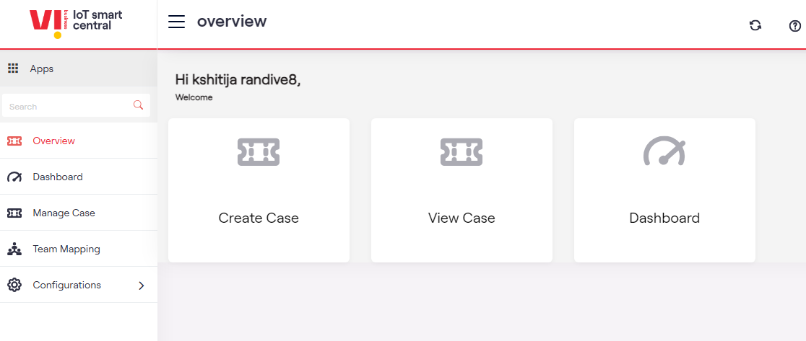
Home Page
Case Management is the portal where we can see the customer-raised Ticket portal

Slide 4
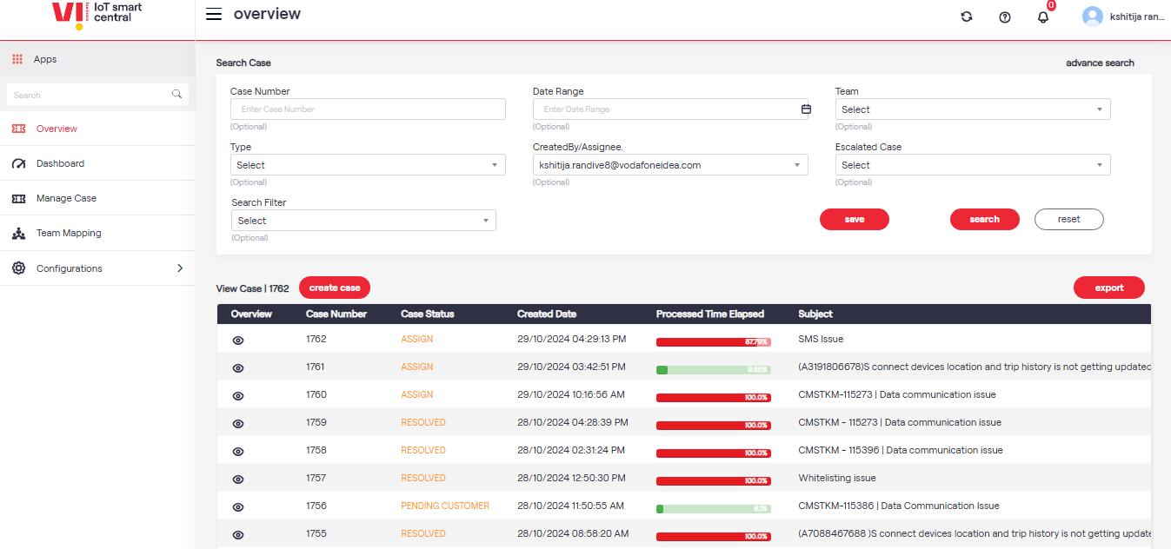
Overview where all the cases will be reflect

Slide 5
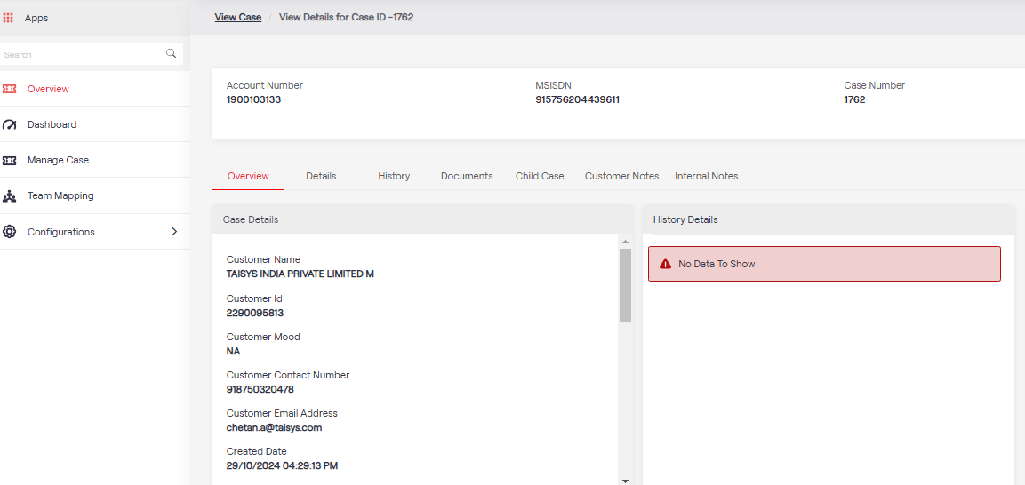
Ticket Details can be visible in the View case

Slide 6
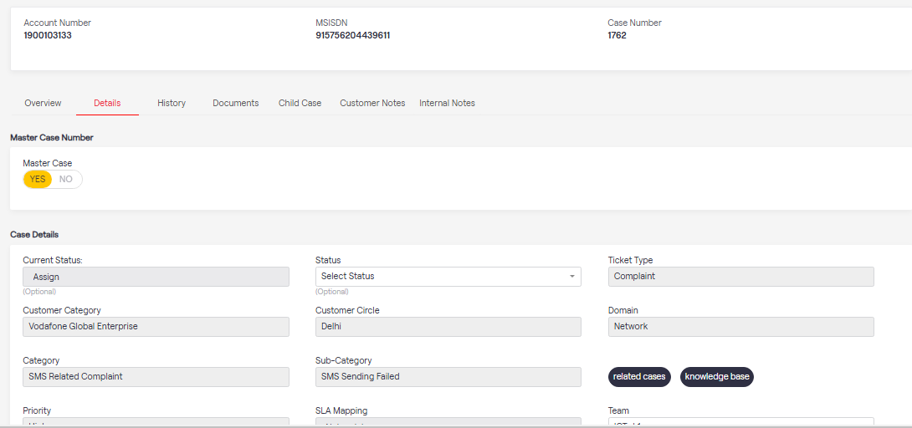
Details Section you will see the customer detail and case back history

Slide 7
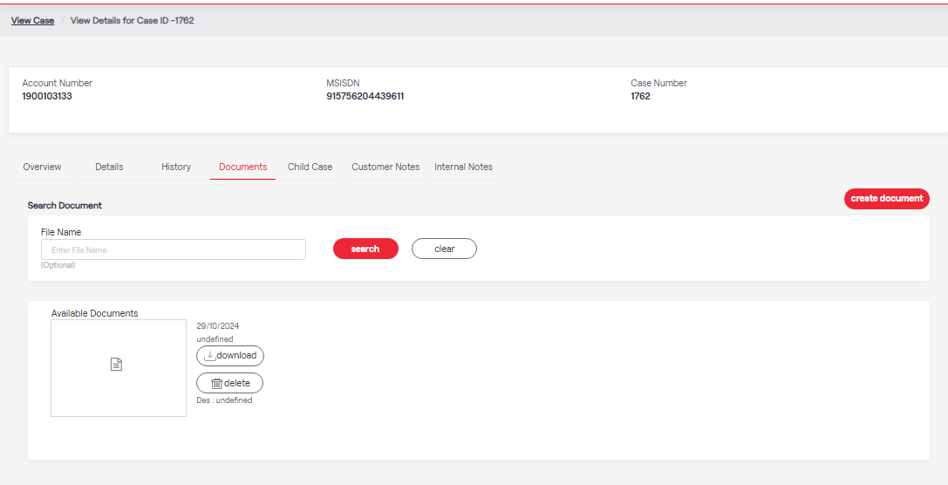
If any attachments is given by the customer will be reflected in Document section

Slide 8
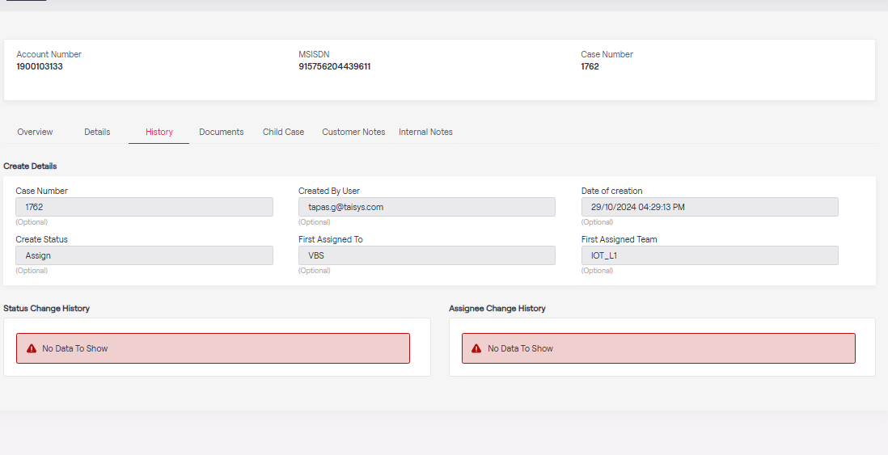
In the history section, you will see the transaction done by the L1 Team.

Slide 9
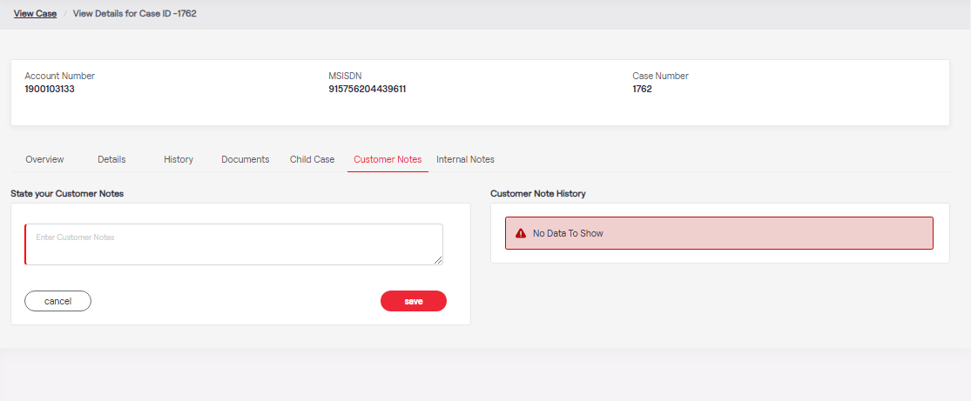
In Customer note, customer communication will be reflecting

Slide 10
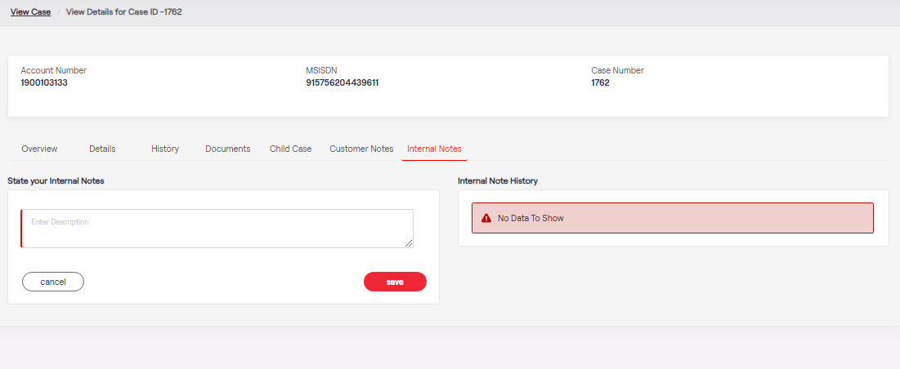
In internal Notes Secondary team communication are maintained

Slide 11
Thank you !

